Slide 1
Regression
Sadia Islam Lecturer
Department of Computer Science and engineering United International University

Slide 2
Regression
Regression is used to understand the relationship between independent and dependent variables. It works with labelled data. e.g. linear regression
Maps input to output where output is
  Numerical
  Real
  Continuous

Slide 3
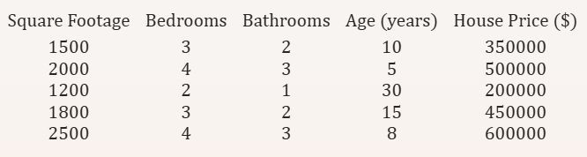
Regression Example
Example of predicting house prices based on square footage, number of bedrooms, number of bathrooms, and age of the house.

Slide 4
Linear Regression
Simple Linear Regression
Multiple Linear Regression
Multivariate Linear Regression

Slide 5
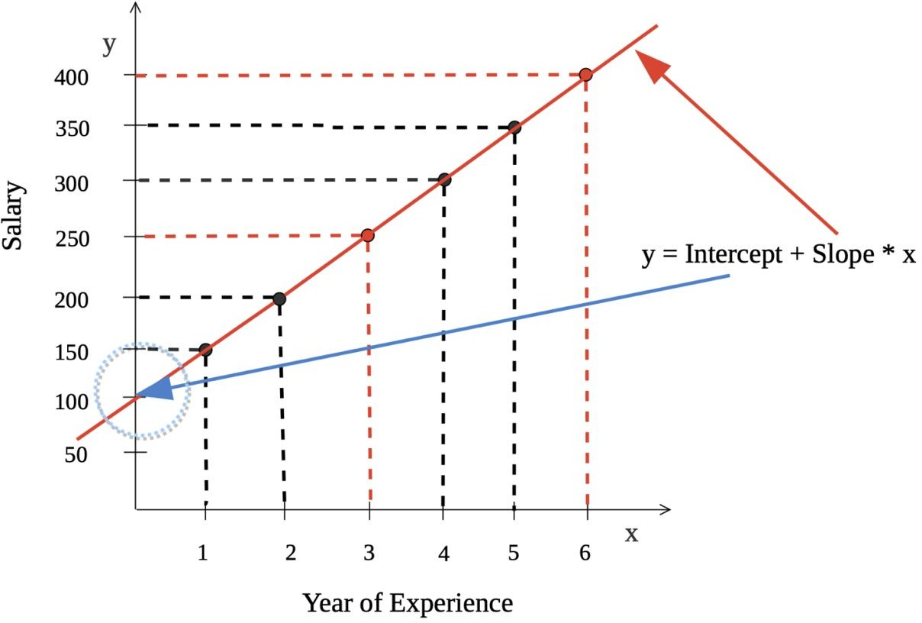
Simple Linear Regression
One input variable (X) and one output variable(Y)
Mapping X to Y using a line
y = ω0 + ω1.x
We need to find ω0 and ω1

Slide 6




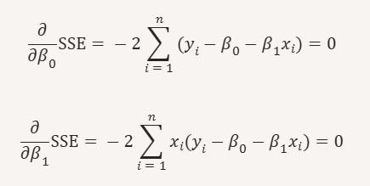
Simple Linear Regression Cont.

Slide 7


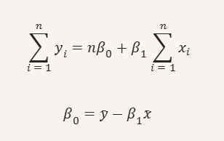
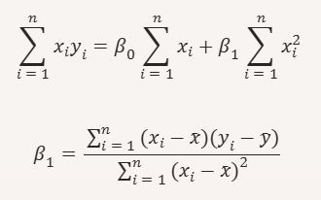
Simple Linear Regression Cont.
From the two equations:

Slide 8
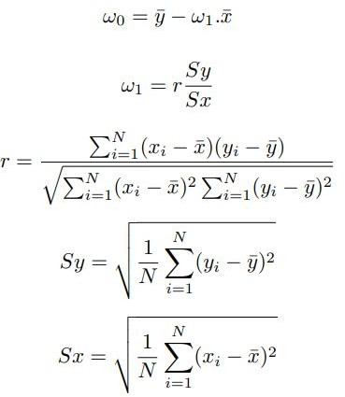
Simple Linear Regression Cont.
Correlation Coefficient,
The standard deviation is calculated as the square root of variance by determining each data point’s deviation relative to the mean.

Slide 9
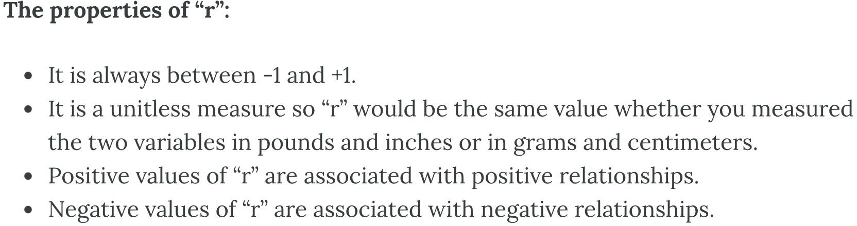
Linear Correlation Coefficient
Because visual examinations are largely subjective, we need a more precise and objective measure to define the correlation between the two variables. To quantify the strength and direction of the relationship between two variables, we use the linear correlation coefficient:

Slide 10
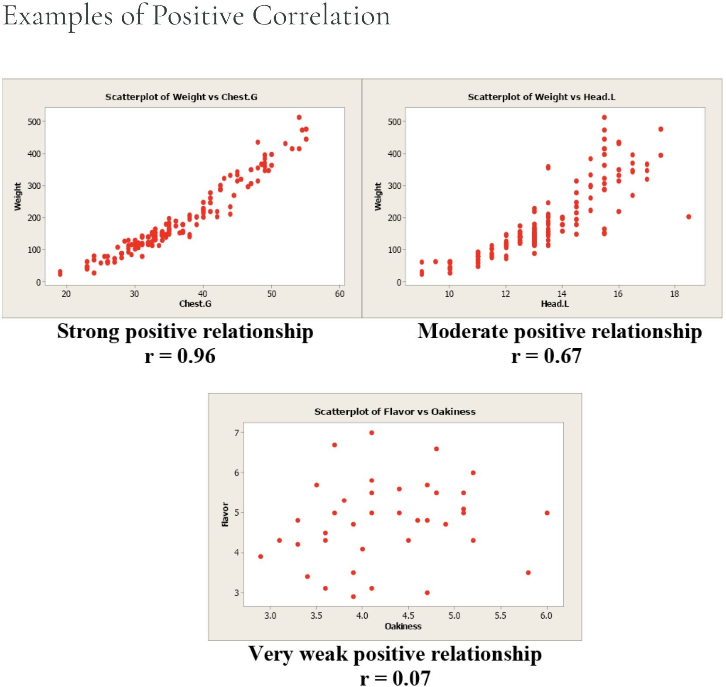
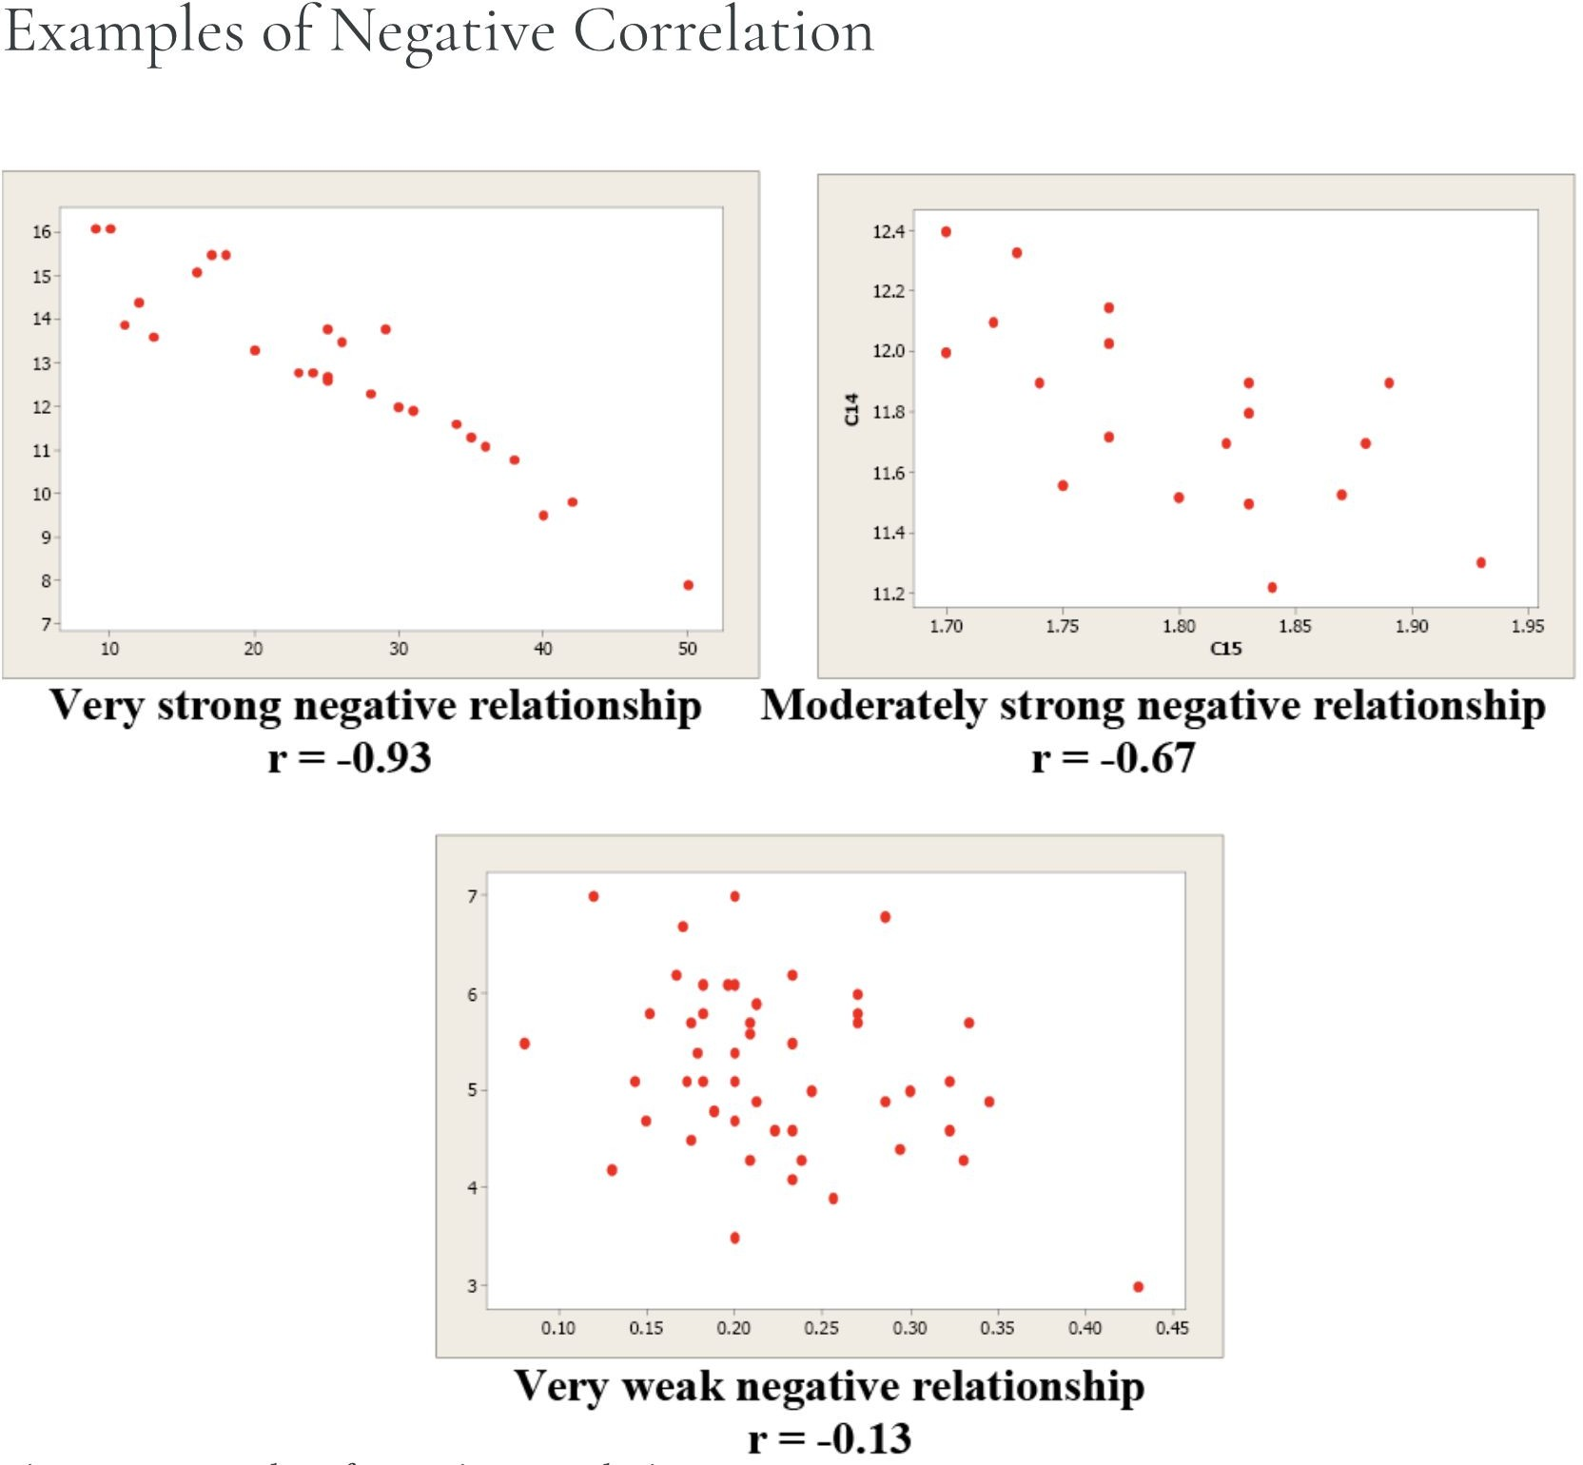

Slide 11
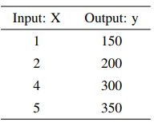
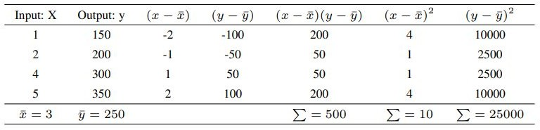
Simple Linear Regression - Example

Slide 12





Simple Linear Regression - Example

Slide 13
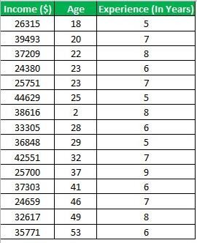
Multiple Linear Regression
Multiple Linear Regression is one of the important regression algorithms which predicts one outcome (dependent variable) using multiple inputs (independent variables).
Notes:
The image explains Multiple Linear Regression (MLR), a statistical method used to model the relationship between one dependent variable (here, "Income") and two or more independent variables (e.g., "Age" and "Experience").
Key Points:
Dependent Variable:
This is the outcome or target variable we want to predict (e.g., "Income ($)").
Independent Variables:
These are the predictors or input variables that influence the dependent variable (e.g., "Age" and "Experience (in Years)").

Slide 14
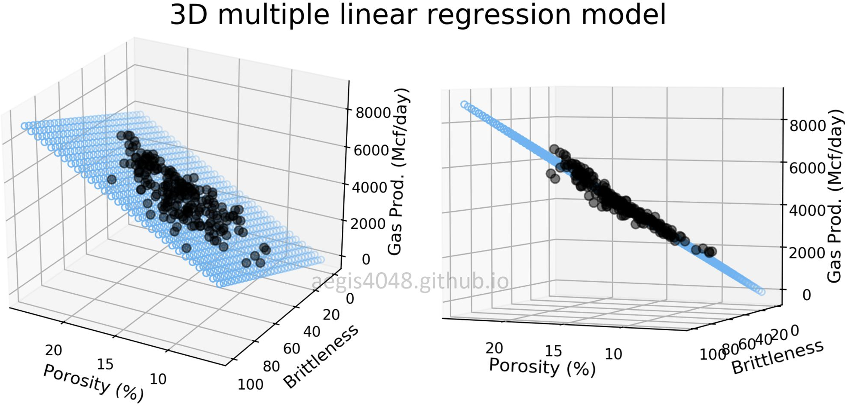

Slide 15
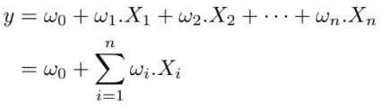
Multiple Linear Regression Cont.
For MLR, the dependent or target variable(Y) must be the continuous/real, but the predictor or independent variable may be of continuous or categorical form.
Each feature variable must model the linear relationship with the dependent variable.
MLR tries to fit a regression line through a multidimensional space of data-points.

Slide 16
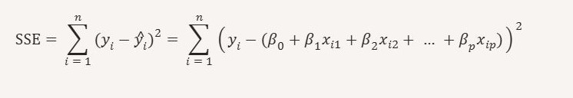
Multiple Linear Regression Cont.

Slide 17
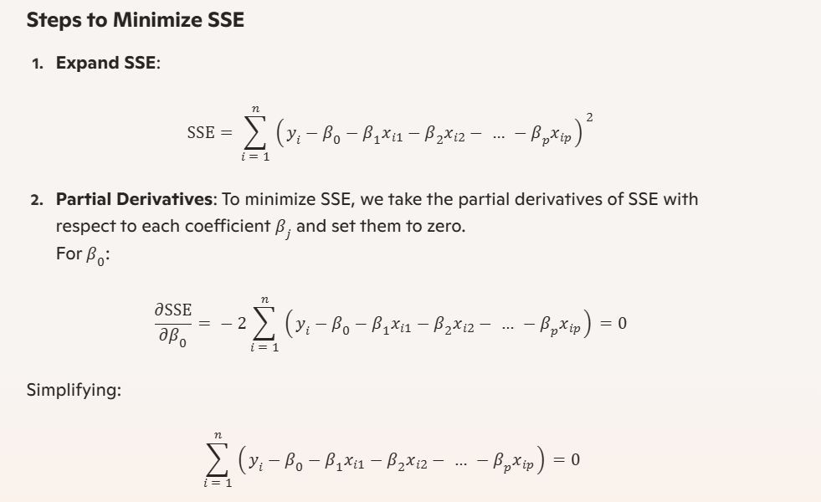
Multiple Linear Regression Cont.

Slide 18
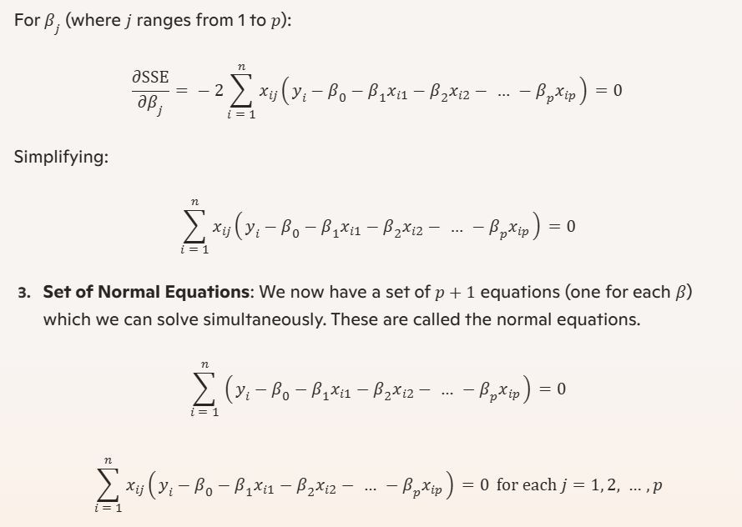
Multiple Linear Regression Cont.

Slide 19
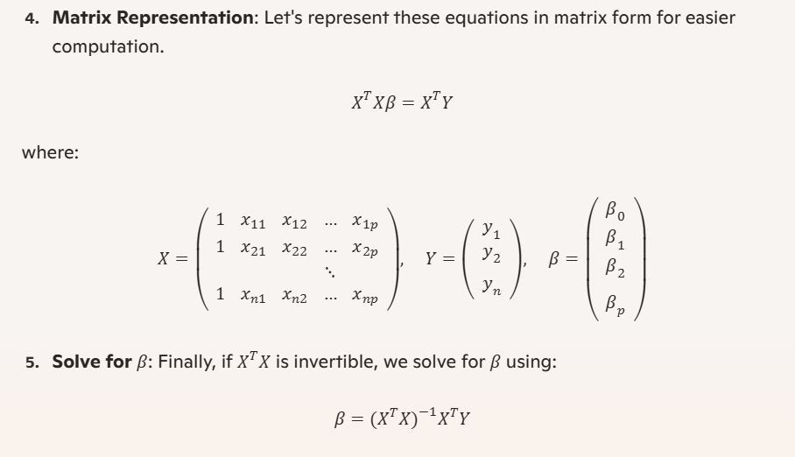
Multiple Linear Regression Cont.

Slide 20
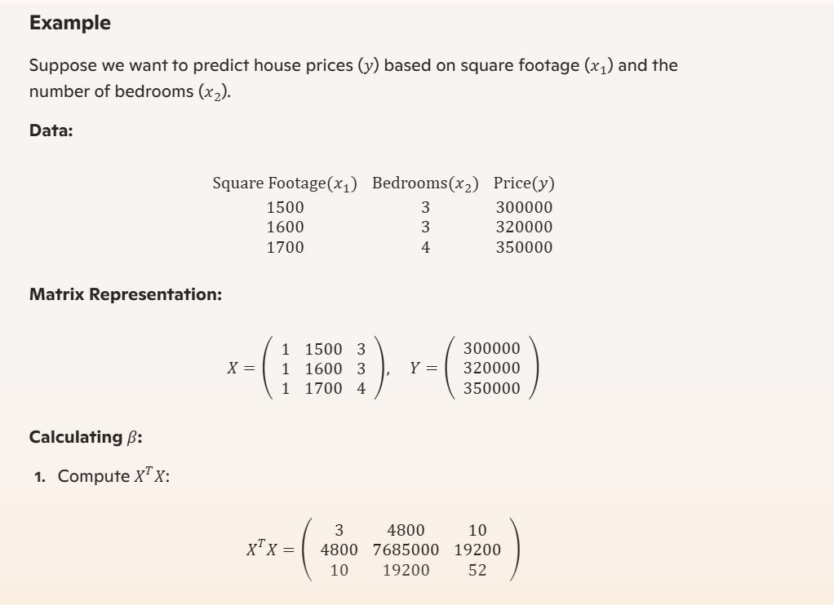
Multiple Linear Regression Cont.

Slide 21
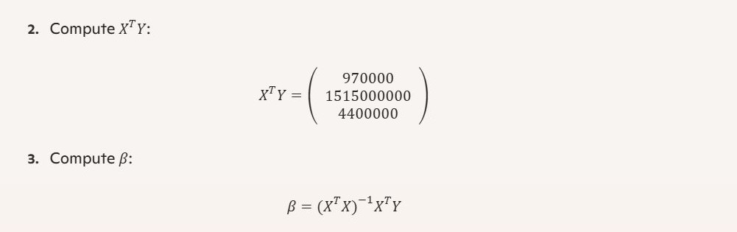
Multiple Linear Regression Cont.

Slide 22
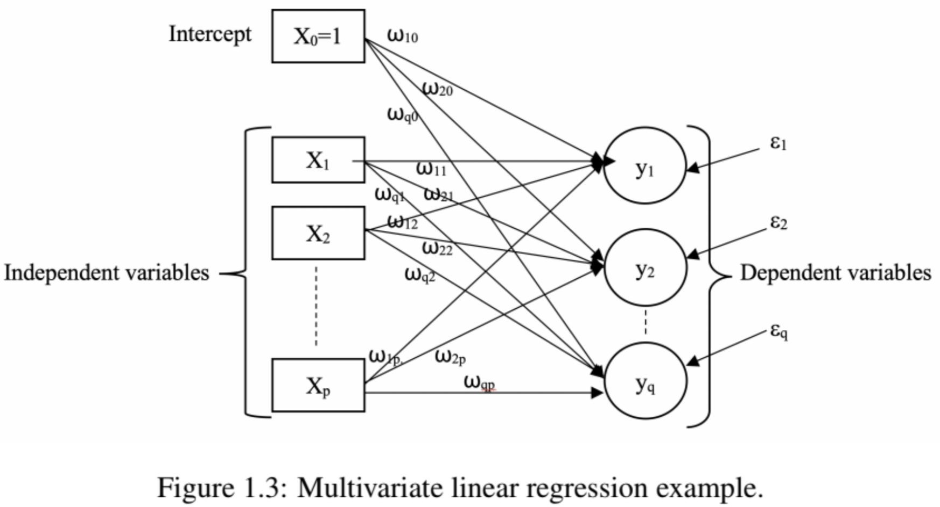

Multivariate Linear Regression
Multivariate Linear Regression (MvLR), also called multivariate multiple regression, is a technique that estimates a single regression model with multiple independent variables and multiple dependent variables.
Notes:
Multivariate Linear Regression (MvLR) predicts multiple outcomes (dependent variables) using multiple inputs (independent variables) in one model

Slide 23
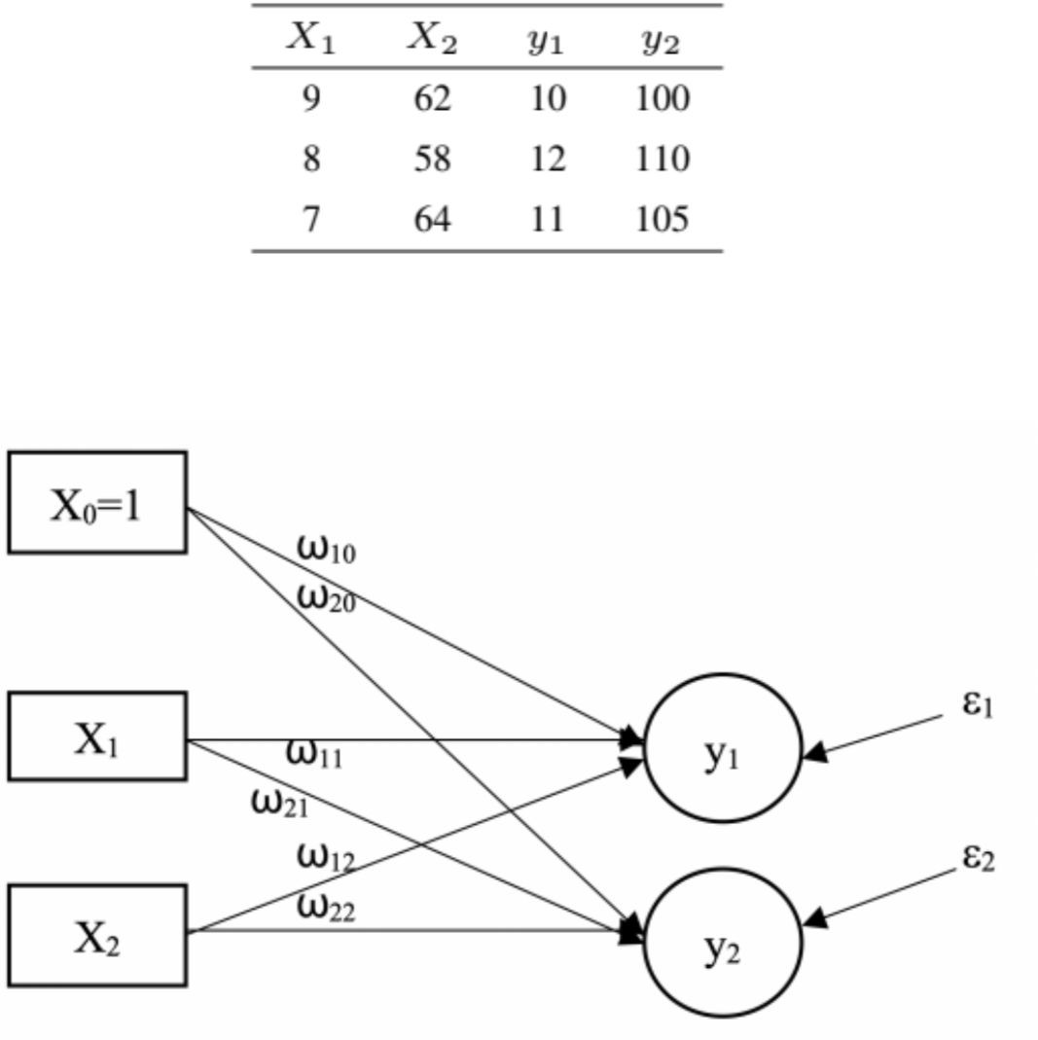
Multivariate Linear Regression Cont.

Slide 24
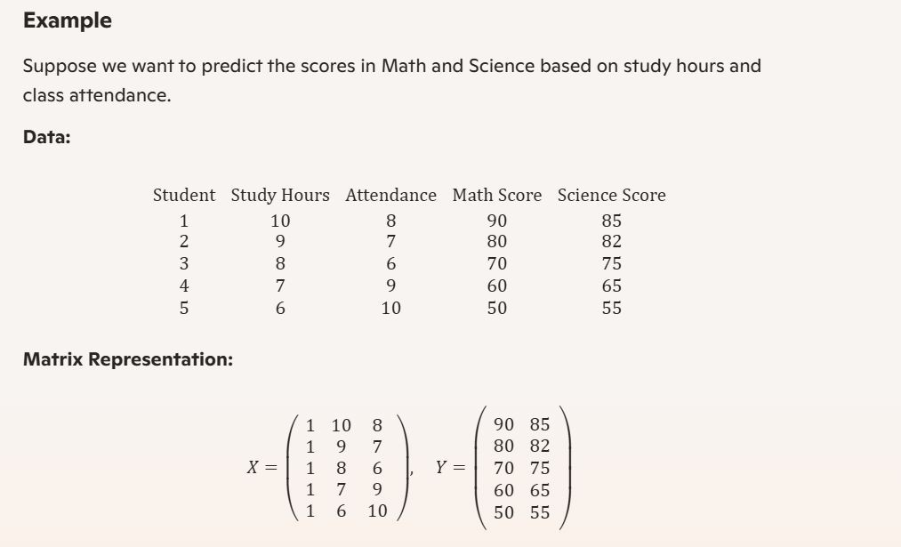
Multivariate Linear Regression Cont.

Slide 25
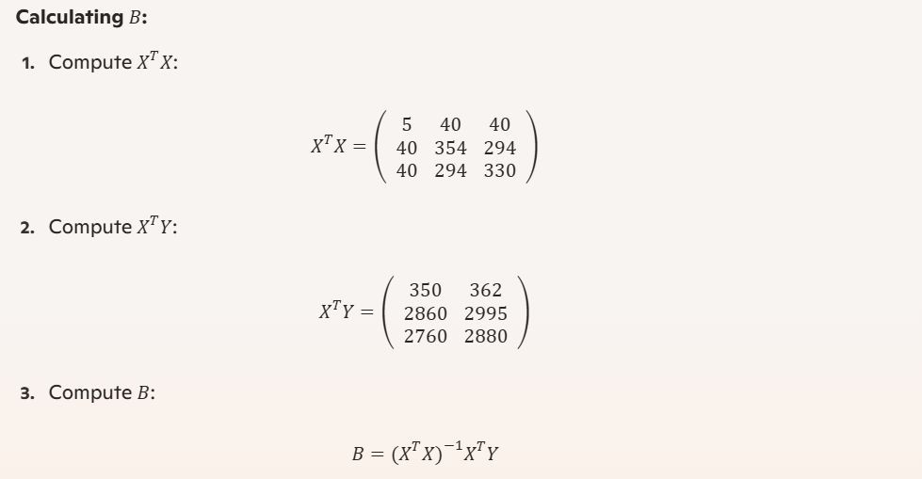
Multivariate Linear Regression Cont.

Slide 26
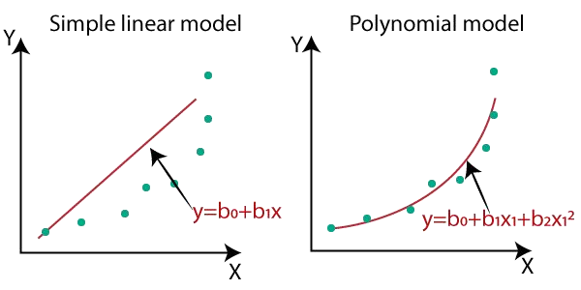
Polynomial Regression
Polynomial regression is a form of Linear regression where only due to the Non-linear relationship between dependent and independent variables, we add some polynomial terms to linear regression to convert it into Polynomial Regression in Machine Learning.
Notes:
Polynomial Regression adds polynomial terms to Linear Regression to handle non-linear relationships between inputs and outputs.

Slide 27
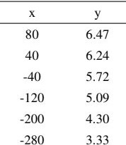

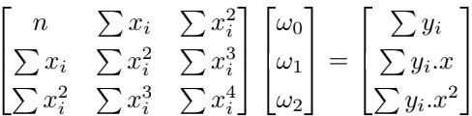
Polynomial Regression Example

Slide 28
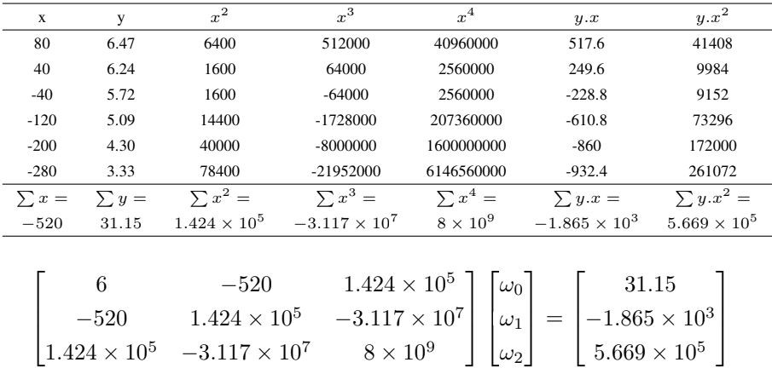
Polynomial Regression Example Cont.

Slide 29


Polynomial Regression Example Cont.

Slide 30
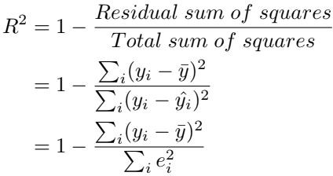

Regression Model Evaluation Matrix
R-squared (R2)
Defined as a number that tells you how well the independent variable(s) in a statistical model explains the variation in the dependent variable. It ranges from 0 to 1, where 1 indicates a perfect fit of the model to the data.
A high (R2), between 85% and 100%, indicates that the model performance moves relatively in line of best fit. A low (R2), at 70% or less, indicates the model does not generally follow the movements of the line of best fit.
The formula for calculating R-squared is:
Notes:
"R-squared (R²) measures how well the independent variables explain the the variation in the dependent variable. It ranges from 0 to 1:
1 = Model fits data perfectly.
85%-100% = Model fits data well(Good fit).
70% or less = Model doesn't fit data well(Poor Fit).
It tells you how much of the data's variability is captured by the model.

Slide 31

Regression Model Evaluation Matrix
Mean Squared Error (MSE) or Mean Squared Deviation (MSD) measures the average of the squares of the errors that’s the average squared difference between the predicted values, yˆ and the actual value, y.
Notes:
Mean Squared Error (MSE) measures how far predictions are from actual values by squaring the errors and averaging them

Slide 32
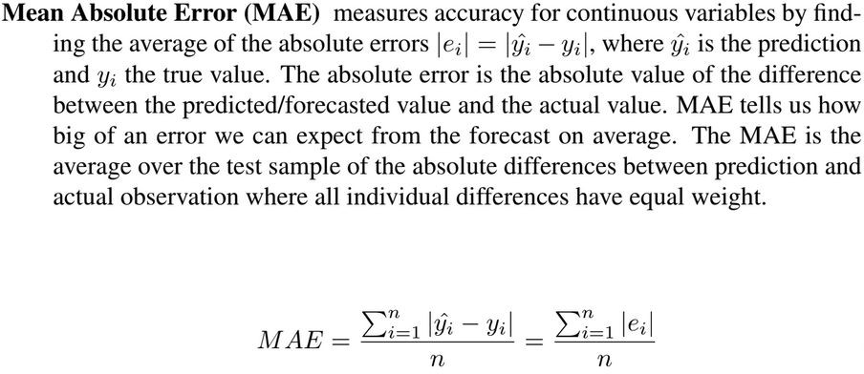
Regression Model Evaluation Matrix
Notes:
Mean Absolute Error (MAE) measures how far predictions are from actual values by finding absolute values of errors and averaging them.

